Slide 1

Design Pattern – Composite and Proxy

Slide 2
Composite Design Pattern
Definition : Composite is a collection of objects, any one of which may be either a composite or just a primitive object .
A tree structure of Simple and Composite objects.
The Composite pattern is designed to deal with situations where a certain object is can be either viewed individually, or as a place holder for a collection of objects of the same type.
The Menu is designed as an hierarchy with parent and child nodes. This Self-referencing tree structure is implemented using this pattern.

Slide 3
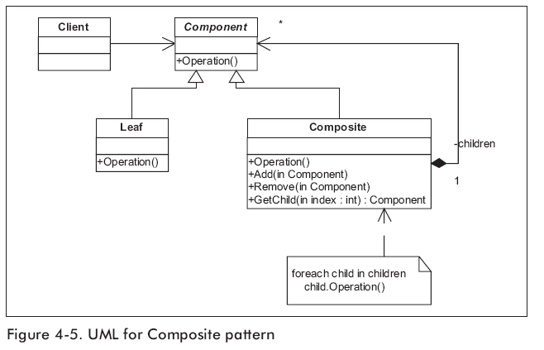
Composite Design Pattern
UML Diagram

Slide 4
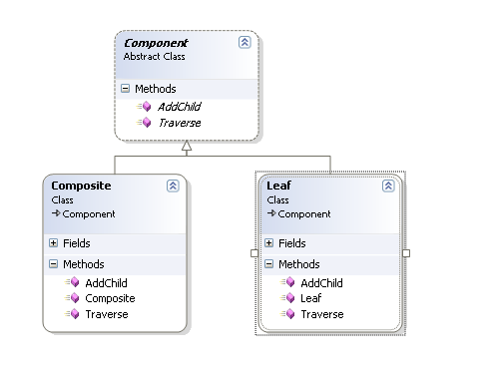
Composite Design Pattern
Class Diagram

Slide 5
Composite Design Pattern
Pattern Example
//the single interface for primitives & composite types.|
abstract class Component
{
abstract public void AddChild(Component c);
abstract public void Traverse();
}
//A primitive type.
class Leaf : Component
{
private int value = 0;
public Leaf(int val)
{
value = val;
}
public override void AddChild(Component c)
{
//no action; This method is not necessary for Leaf
}

Slide 6
Composite Design Pattern
public override void Traverse()
{
Console.WriteLine("Leaf:" + value);
}
}
//A composite type.
class Composite : Component
{
private int value = 0;
private ArrayList ComponentList = new ArrayList();
public Composite(int val)
{
value = val;
}
public override void AddChild(Component c)
{
ComponentList.Add(c);
}

Slide 7
Composite Design Pattern
public override void Traverse()
{
Console.WriteLine("Composite:" + value);
foreach (Component c in ComponentList)
{
c.Traverse();
}
}
}
class MyMain
{
public static void Main()
{
//creating a TREE structure.
Composite root = new Composite(100);// Root
Composite com1 = new Composite(200); //Composite 1
Leaf l1 = new Leaf(10);//Leaf1
Leaf l2 = new Leaf(20);//Leaf2

Slide 8
Composite Design Pattern
//Add two leafs to composite1
com1.AddChild(l1);
com1.AddChild(l2);
Leaf l3 = new Leaf(30);//Leaf3
root.AddChild(com1);//Add composite1 to root
root.AddChild(l3);//Add Leaf3 directly to root
root.Traverse();//Single method for both types.
}
}

Slide 9
Composite Design Pattern
Composite Benefits
The Composite pattern provides the capability to group objects together in a collection and interact with the group as whole in a similar manner as would interact with an individual member of the group.
.Net Examples of Compsoite Pattern
Composite UI Application Block

Slide 10
Proxy Design Pattern
Definition :Provide a surrogate or placeholder for another object to control access it.
A Proxy object can act as the intermediary between the client and target object.
The most common usage for proxy is when you have two incompatible systems or two separate domains and wish to allow these systems or domains to have access point to each other.

Slide 11
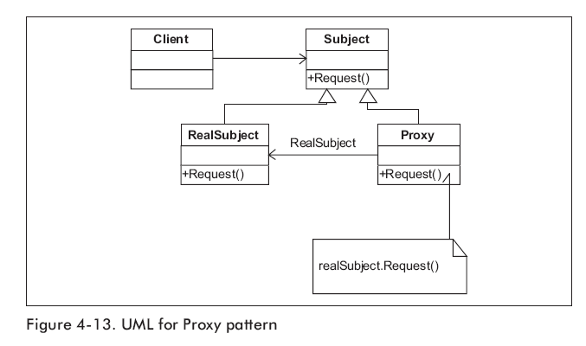
Proxy Design Pattern
UML Diagram

Slide 12
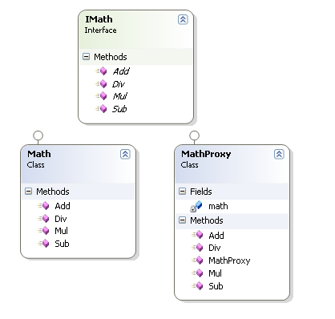
Proxy Design Pattern
Class Diagram

Slide 13
Proxy Design Pattern
Pattern Example
// "Subject"
public interface IMath
{
double Add(double x, double y);
}
// "RealSubject"
class Math : IMath
{
public double Add(double x, double y) { return x + y; }
}

Slide 14
Proxy Design Pattern
// "Proxy Object"
class MathProxy : IMath
{
Math math;
public MathProxy()
{
math = new Math();
}
public double Add(double x, double y)
{
return math.Add(x, y);
}
}

Slide 15
Proxy Design Pattern
class MainApp
{
static void Main()
{
// Create math proxy
MathProxy p = new MathProxy();
// Do the math
} Console.WriteLine(p.Add(4, 2));
}

Slide 16
Resources
Books
  Design Patterns – GOF
  Design Patterns – Christopher G Lasater

Slide 17
Questions
If (Questions == null || Questions.Count == 0)
{
Thank you;
}

